Slide 1
FlingOS
Teaching students on their level

Slide 2
Background
Primary and secondary schools
National Curriculum
Microbit
Raspberry Pi
High-level languages:
Python,
Java,
JavaScript,
C#
University modules
Computer architecture : 1st year
Concurrency : 2nd year

Slide 3
Historical approach
Teach C
Then computer architecture
Then (some) operating systems
Then concurrency
Problem!
Harder to go from High-level (e.g. C#) to low-level (C/ASM) than other way around
But: Students are coming to University with prior high-level knowledge

Slide 4
New approach
Bridge the gap between high and low level
Use familiar languages
Parallel teaching of C and computer architecture
Better understanding e.g. pointers
 | Module 1 | Module 2 | Module 3
Year 1 | C | Architecture | Algorithms
Year 2 | Go / CSP | Concurrency | Language Eng.
Year 3 |  | Operating Systems | HPC

Slide 5
FlingOS
The educational operating system

Slide 6
FlingOS
Familiar
C#
Object oriented
Simple
Un-optimised
Traceable
Documented
Inline
Articles
Video tutorials

Slide 7
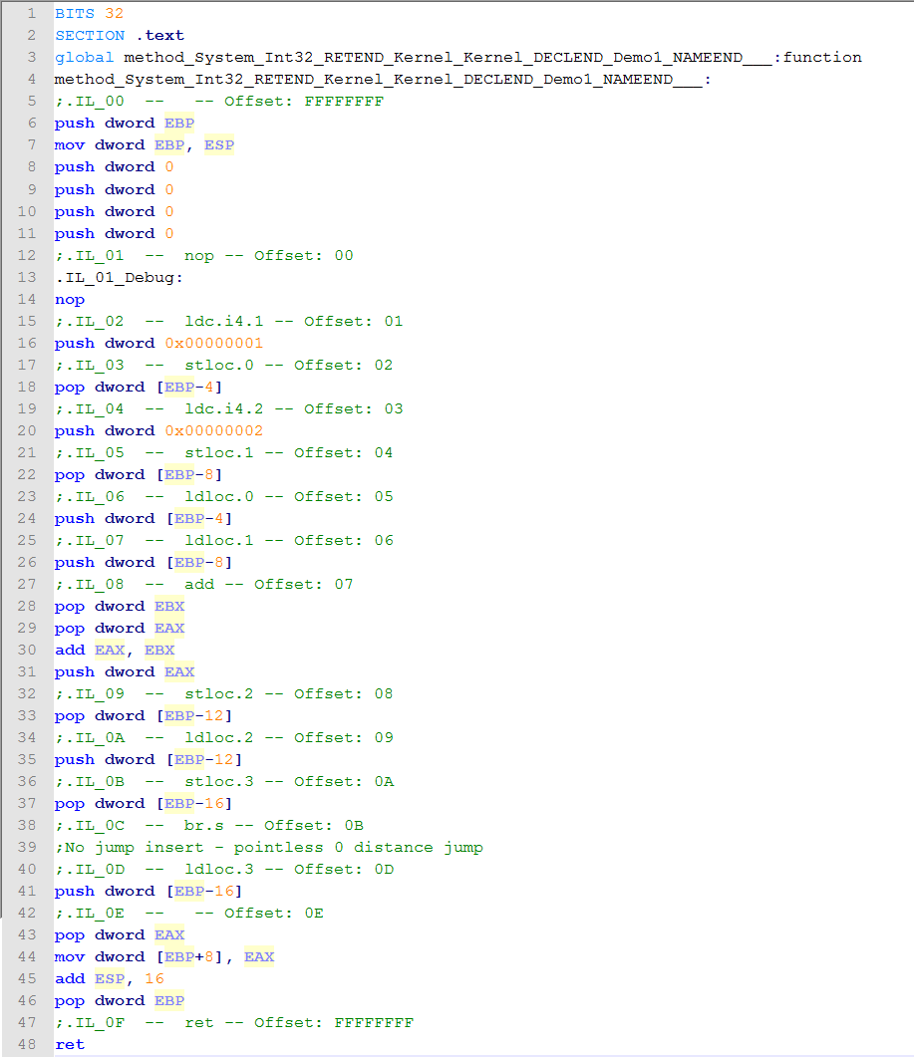
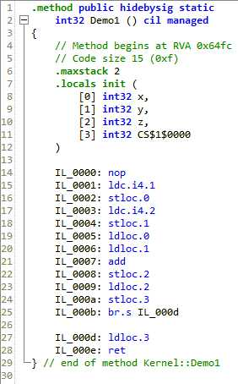
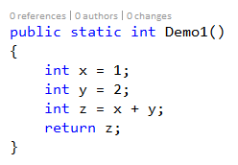
Example
Computer Architecture
Compiler
Trace C# to IL
Trace IL to ASM

Slide 8
Future
Basic OS is ready!
Now it’s time to draw it all together…
Starter kit
Target : A-level / 1st year university
Aim : Basic operating system (concurrency)
Platforms : Virtual machine, simple h/w platform
Price-point : £40 to £50
How?
Extended articles and videos
Kit sold online

Slide 9

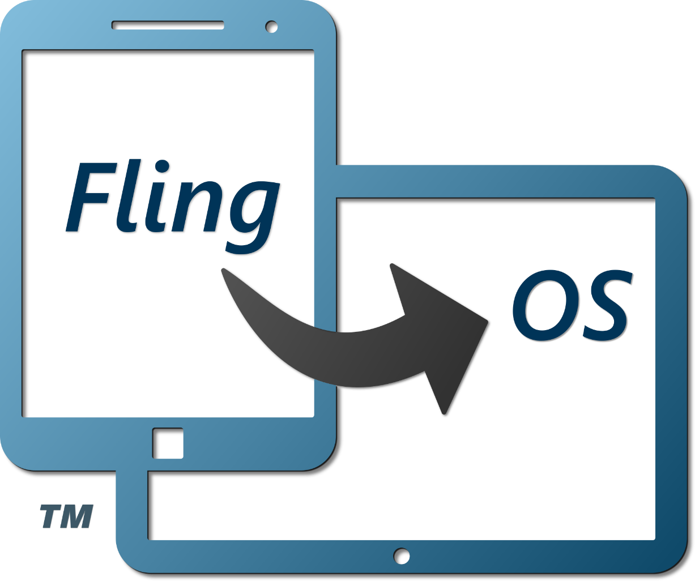
FlingOS
Ed Nutting – contact@flingos.co.uk www.flingos.co.uk
facebook.com/FlingOperatingSystem @Fling_OS

